Slide 1
OPIM 5604
Predictive Modeling
Decision Trees & Regression Trees
Jennifer Eigo, Instructor in-Residence

Slide 2
Tree Overview
Decision Trees
Classification model
Categorical target variable
Regression Trees
Predict a continuous target variable

Slide 3
Tree Models
Very interpretable
Rule based; no math formulas
Easy to use
No transformations
No bucketing
No assumed linear relationship
Can help with variable selection
Split points become nodes on the tree
Leaves are the terminal nodes that show probabilities of target class membership

Slide 4
Decision Trees and Rules
Goal: Classify or predict an outcome based on a set of predictors
The output is a set of rules represented by tree diagrams
Example Rules:
Goal: Classify a record as “will accept credit card offer” or “will not accept”
Rule might be “IF (Income >= 99) AND (Education = 1) AND (Family < 3) THEN Prob(Class = 1) = 0.0077 (classify as non-acceptor)

Slide 5
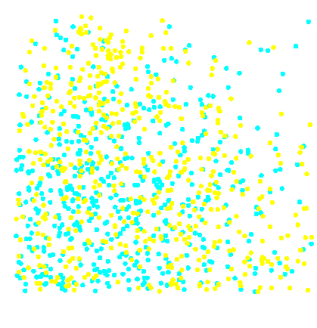
Simple Prediction Example
Training Data
Predict probability of yellow for each x₁ and x₂.
1.0
0.9
0.8
x₂
0.7
<0.63
≥0.63
0.6
x₂
0.5
0.4
x₁
x₁
0.3
<0.52
≥0.52
<0.51
≥0.51
0.2
0.1
0.0
70%
0.0
0.1
0.2
0.3
0.4
0.5
0.6
0.7
0.8
0.9
1.0
40%
x₁
55%
60%

Slide 6
Simple Prediction Example
Training Data
Predict dot color located here:
1.0
0.9
0.8
x₂
0.7
<0.63
≥0.63
0.6
x₂
0.5
0.4
x₁
x₁
0.3
<0.52
≥0.52
<0.51
≥0.51
0.2
0.1
0.0
70%
0.0
0.1
0.2
0.3
0.4
0.5
0.6
0.7
0.8
0.9
1.0
40%
x₁
x₁
55%
60%

Slide 7
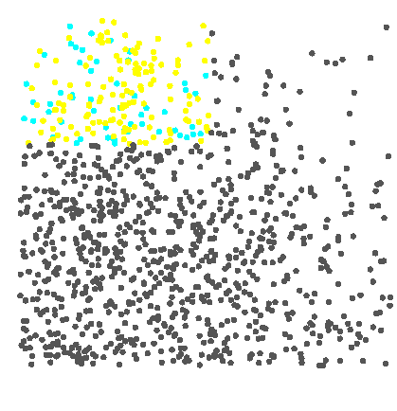
Simple Prediction Example
Training Data
Decision =
Probability = 0.70
1.0
0.9
0.8
x₂
0.7
<0.63
<0.63
≥0.63
0.6
x₂
0.5
x₂
0.4
x₁
x₁
x₁
0.3
<0.52
<0.52
≥0.52
≥0.52
<0.51
≥0.51
≥0.51
0.2
0.1
0.0
70%
0.0
0.1
0.2
0.3
0.4
0.5
0.6
0.7
0.8
0.9
1.0
40%
40%
x₁
55%
55%
60%
60%

Slide 8
Recursive Partitioning (Growing the Tree)

Slide 9
Splitting on Categorical Variables
Examine all possible ways in which the categories can be split.
E.g., categories A, B, C can be split 3 ways
{A} and {B, C}
{B} and {A, C}
{C} and {A, B}
With many categories, # of potential splits becomes huge

Slide 10
Splitting on Categorical Variables
For ordinal data (ordered categories) there is an option for the splits to respect ordering
Example: An ordinal predictor takes on the values 1, 2, 3, or 4
The data can be split 3 ways:
{1} and {2, 3, 4}
{1, 2} and {3, 4}
{1, 2, 3} and {4}

Slide 11
Splitting on Continuous Variables
Order records according to one variable
Split at the first value
Measure the impurity in the two subsets
Split at the next value, and continue
Repeat for the other variable(s)
For all variables, the split value that drives the lowest impurity is selected as the split point

Slide 12

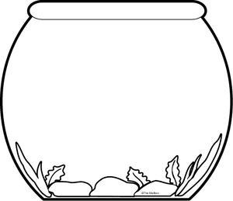
Desirable Splits
What is the probability of choosing a yellow ball blindfolded?

Slide 13
Desirable Splits
Let’s split the 20 balls into two different bowls.
Do either of these smaller bowls improve your chances of choosing a yellow ball?
A
B

Slide 14
Measuring Desirable Splits
We are seeking a yellow ball
Intuitively, what’s the better split?
A
B

Slide 15
Measuring Desirable Splits
Gini Impurity – measure of how impure the leaves are on each side of a split
Gini Impurity of a Leaf = 1 - (Count Yes/Count Leaf)^2 - (Count No/Count Leaf)^2
Then take weighted average of both leaves
Weighted Avg Gini Impurity = (Left Count/ Total Count) x Gini Left + (Right Count/Total Count) x Gini Right
A
B

Slide 16
Measuring Desirable Splits
I choose B
Split A Left Gini = 1 – (3/10)^2 – (7/10)^2 = 0.42
Split A Right Gini = 1 – (3/10)^2 – (7/10)^ 2 = 0.42
Split A Avg Gini = (10/20)x0.42 + (10/20)x0.42 = 0.42
Split B Left Gini = 1 – (1/10)^2 – (9/10)^2 = 0.18
Split B Right Gini = 1 – (5/10)^2 – (5/10)^ 2 = 0.5
Split B Avg Gini = (10/20)x0.18 + (10/20)x0.5 = 0.34
A
B

Slide 17
Measuring Desirable Splits
Information Gain
How much did the split improve from the previous impurity before the split?
Information Gain = Node Gini – Weighted Gini
Gini Impurity – lower is better
Information Gain – higher is better

Slide 18
Decision Tree Split Search
left
right
1.0
0.9
0.8
0.7
0.6
Calculate the Gini Impurity of every possible partition of input x₁.
The lower the Gini the better the split.
The higher the Information Gain the better the split.
x₂
0.5
0.4
0.3
0.2
0.1
0.0
0.0
0.1
0.2
0.3
0.4
0.5
0.6
0.7
0.8
0.9
1.0
x₁

Slide 19
Decision Tree Split Search
left
right
0.52
53%
42%
max Information Gain
0.0095
1.0
0.9
47%
58%
0.8
0.7
0.6
x₂
0.5
0.4
Highest Information Gain is at x₁ = 0.52.
This is the split where the sides are the least impure.
0.3
0.2
0.1
0.0
0.0
0.1
0.2
0.3
0.4
0.5
0.6
0.7
0.8
0.9
1.0
x₁

Slide 20
Decision Tree Split Search
left
right
53%
42%
max Information Gain(x₁)
0.0095
1.0
0.9
47%
58%
0.8
0.7
0.6
x₂
0.5
bottom
top
0.4
0.3
0.2
0.1
0.0
0.0
0.1
0.2
0.3
0.4
0.5
0.6
0.7
0.8
0.9
1.0
Repeat for x₂
x₁

Slide 21
Decision Tree Split Search
left
right
53%
42%
1.0
max Information Gain(x₁)
0.0095
0.9
47%
58%
0.8
0.7
0.63
0.6
x₂
0.5
bottom
top
0.4
54%
35%
max Information Gain(x₂)
0.0492
0.3
0.2
46%
65%
0.1
0.0
0.0
0.1
0.2
0.3
0.4
0.5
0.6
0.7
0.8
0.9
1.0
x₁

Slide 22
Decision Tree Split Search
left
right
53%
42%
1.0
max
Information Gain(x₁)
0.0095
0.9
47%
58%
0.8
0.7
0.6
Compare partition Information Gains.
x₂
0.5
bottom
top
0.4
54%
35%
max
Information Gain(x₂)
0.0492
0.3
0.2
46%
65%
0.1
0.0
0.0
0.1
0.2
0.3
0.4
0.5
0.6
0.7
0.8
0.9
1.0
Information Gain for x₂ is higher
x₁

Slide 23
Decision Tree Split Search
1.0
x₂
0.9
<0.63
≥0.63
0.8
0.7
0.63
0.6
x₂
0.5
0.4
Create a partition rule from the best partition across all inputs.
0.3
0.2
0.1
0.0
0.0
0.1
0.2
0.3
0.4
0.5
0.6
0.7
0.8
0.9
1.0
x₁

Slide 24
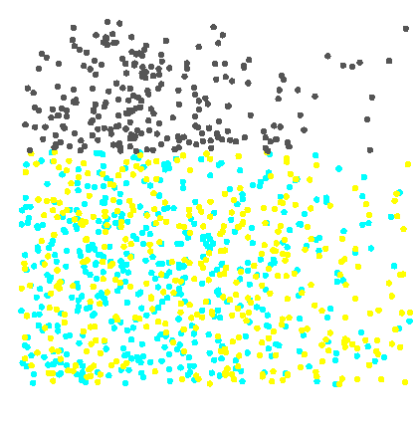
Decision Tree Split Search
1.0
x₂
0.9
<0.63
≥0.63
0.8
0.7
0.6
x₂
0.5
0.4
Repeat the process in each subset.
0.3
0.2
0.1
0.0
0.0
0.1
0.2
0.3
0.4
0.5
0.6
0.7
0.8
0.9
1.0
x₁

Slide 25
Decision Tree Split Search
left
right
62%
55%
1.0
max
Information Gain (x₁=0.52)
0.0572
0.9
38%
45%
0.8
0.7
0.6
x₂
0.5
bottom
top
0.4
39%
55%
max
Information Gain (x₂=0.02)
0.0201
0.3
0.2
61%
45%
0.1
0.0
0.0
0.1
0.2
0.3
0.4
0.5
0.6
0.7
0.8
0.9
1.0
Information Gain for x₁ is higher
x₁

Slide 26
Decision Tree Split Search
1.0
x₂
0.9
<0.63
≥0.63
0.8
0.7
x₁
0.6
<0.52
≥0.52
x₂
0.5
0.4
0.3
0.2
Create a second partition rule.
0.1
0.0
0.0
0.1
0.2
0.3
0.4
0.5
0.6
0.7
0.8
0.9
1.0
x₁

Slide 27
Decision Tree Split Search
1.0
0.9
0.8
0.7
0.6
x₂
0.5
0.4
0.3
0.2
0.1
0.0
0.0
0.1
0.2
0.3
0.4
0.5
0.6
0.7
0.8
0.9
1.0
Repeat to form a maximal tree.
x₁

Slide 28
Maximal Tree
Tree splits developed on Training Data
Build tree to maximal size
Stop based on leaf purity
Stop based on stopping rule
maximal
tree
Create sequence of models with increasing complexity.
Maximal tree is most complex model in sequence.

Slide 29
Avoid Overfitting (Pruning the Tree)

Slide 30
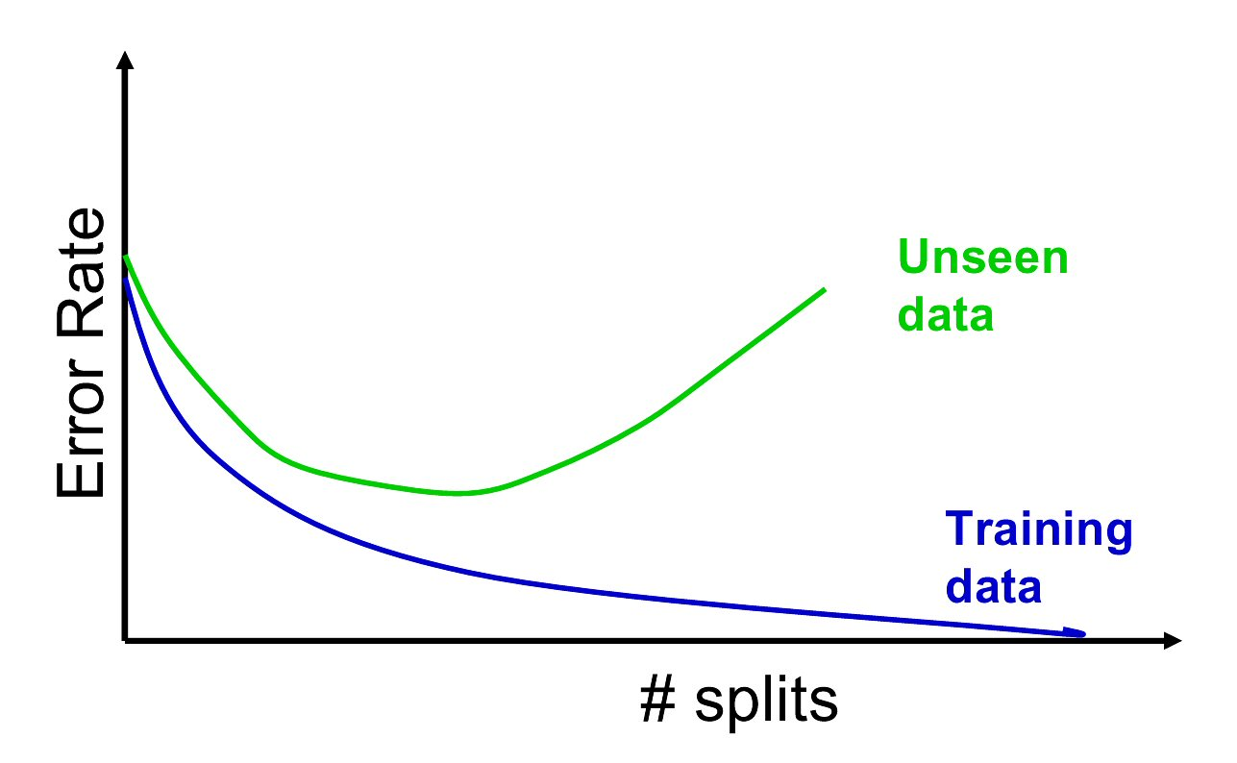
Full Tree Error Rate

Slide 31
Pruning the Tree
From the maximal tree, consider trimming off one split from various spots. Keep the model with best validation assessment.
Repeat for subsequent models, decreasing by one split each time, until all subtrees are considered.
Compare validation assessment between tree complexities.
Choose the simplest model with the highest validation assessment.
model
complexity
validation
assessment

Slide 32
Hyperparameter Tuning
Set parameters to use in stopping rules on how big to grow the tree
Max_depth – limits how deep the tree can grow
Min_samples_split – sets the minimum number of records in a node for it to split again
Min_samples_leaf – sets the minimum number of samples allowed to be in a leaf

Slide 33
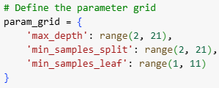
Grid Search
Define ranges of values for each parameter
Retunes the model varying each parameter one at a time

Slide 34
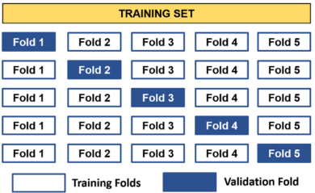
K-fold Cross Validation
Split the training data into K partitions
Hold out the first portion of the data and train the model on the other four portions
Apply the model to Fold 1
Record the F1 Score from Fold 1
Retrain the model on Folds 1, 3, 4, and 5
Apply the model to Fold 2
Record the F1 Score from Fold 2

Slide 35
K-fold Cross Validation
Repeat until you have 5 F1 Scores for the 5 training runs
Average the 5 F1 Scores

Slide 36
Grid Search with K-fold Validation
Set the starting parameters
Train the model 5 times, once for each fold
Record the average F1 Score from 5 runs
Set the next parameters
Train the model 5 times, once for each fold
Record the average F1 Score form 5 runs
Repeat until all parameters have been tried
Select the parameters that yielded the lowest average F1 Score

Slide 37
Grid Search with K-fold Validation
For this set up…
… there are 19 x 19 x 10 parameter combinations!
And each parameter configuration is run 5 times with different holdout samples.
That’s a total of 3610 x 5, or 18,050 runs!
Note: The ranges above are not inclusive of the last number.

Slide 38
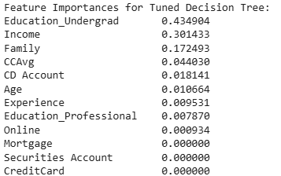
Variable Selection
This is automatic! Splits only happen on the next best variable
Feature Importance shows us this
UG Education is the most important
Some variables remain unused like CreditCard

Slide 39
Regression Trees

Slide 40
Regression Trees for Prediction
Used with continuous outcome variable
Procedure similar to classification tree
Many splits attempted, choose the one that minimizes the variance within subgroup
Prediction is the average of the numerical target variable (rather than a probability)

Slide 41
Regression Trees for Prediction
Use hyperparameter tuning to get the optimal tree size
Max_depth – limits how deep the tree can grow
Min_samples_split – sets the minimum number of records in a node for it to split again
Min_samples_leaf – sets the minimum number of samples allowed to be in a leaf
Feature importance shows which variables were used in the model

Slide 42
Advantages of trees
Easy to use, understand
Produce rules that are easy to interpret & implement
Variable selection & reduction is automatic
Do not require the assumptions of statistical models

Slide 43
Disadvantages
May not perform well where there is structure in the data that is not well captured by horizontal or vertical splits
Since the process deals with one variable at a time, no way to capture interactions between variables

Slide 44
Summary
Classification and Regression Trees are an easily understandable and transparent method for predicting or classifying new records
A tree is a graphical representation of a set of rules
Trees must be pruned to avoid over-fitting of the training data
Gini Impurity and Information Gain help find optimal tree size
As trees do not make any assumptions about the data structure, they usually require large samples

